Slide 1
Ai Medical Report Summerizer
SlideMake.com

Slide 2
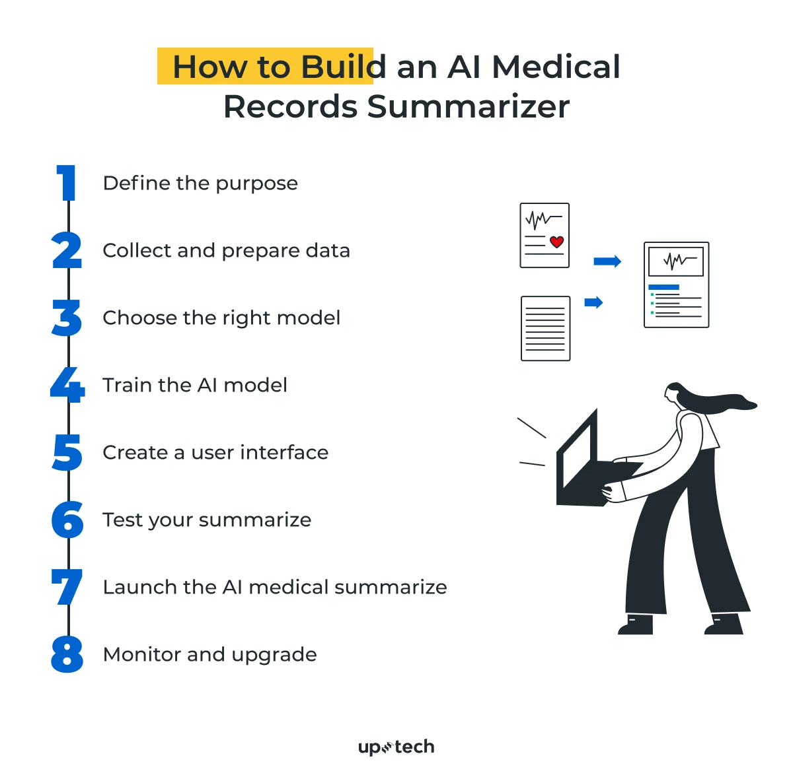
Introduction to AI Medical Report Summarizer
AI medical report summarizers utilize advanced algorithms to extract key information from lengthy medical documents.
They aim to improve efficiency and accuracy in clinical workflows.
This technology is increasingly adopted in healthcare settings worldwide.
Notes:
Image source: https://assets.website-files.com

Slide 3

Importance of Medical Report Summarization
Medical reports contain critical patient information that needs quick interpretation.
Summarization reduces the time clinicians spend reading detailed reports.
Accurate summaries support better decision-making and patient outcomes.
Notes:
Image source: https://i.marketingprofs.com

Slide 4
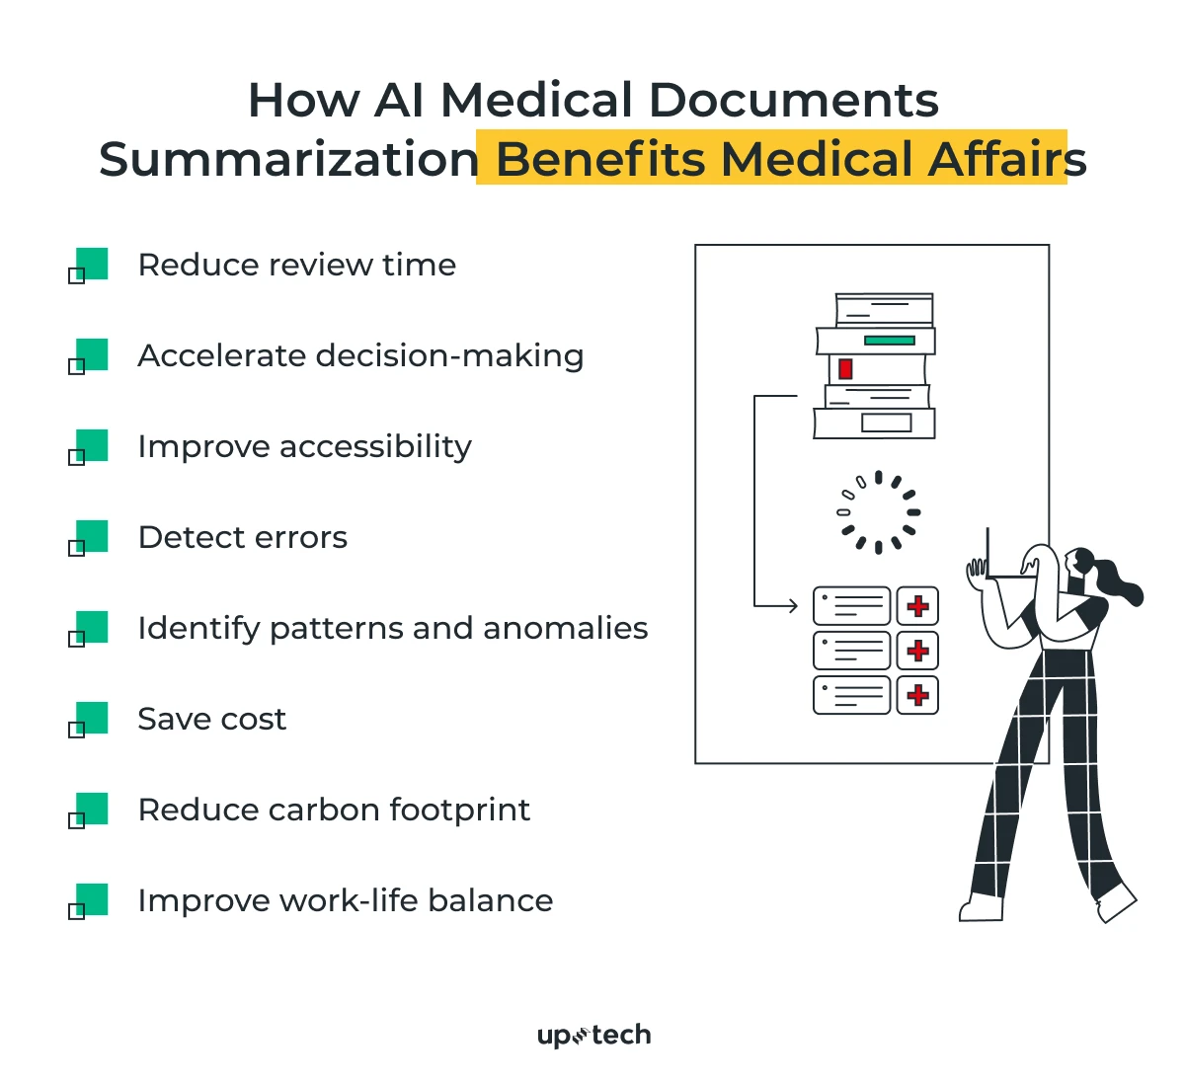
Key Features of AI Medical Summarizers
They leverage natural language processing (NLP) to understand medical terminology.
Summarizers can identify and highlight relevant clinical findings automatically.
They are capable of handling various types of medical documents, including radiology and pathology reports.
Notes:
Image source: https://cdn.prod.website-files.com

Slide 5
Technologies Behind AI Summarization
Deep learning models like transformers are commonly used for contextual understanding.
Machine learning algorithms are trained on large datasets of medical reports.
Integration with electronic health records (EHR) systems enhances usability.
Notes:
Image source: https://assets.website-files.com

Slide 6
Benefits of Using AI Summarizers in Healthcare
They significantly reduce the time required to review patient reports.
Summarizers improve consistency and reduce human errors.
They enable clinicians to focus more on patient care rather than documentation.
Notes:
Image source: https://i.marketingprofs.com

Slide 7
Challenges in AI Medical Report Summarization
Ensuring the accuracy and reliability of generated summaries remains a concern.
Variability in report formats can complicate the summarization process.
Data privacy and compliance with regulations like HIPAA are critical considerations.
Notes:
Image source: https://assets-global.website-files.com

Slide 8
Current Applications and Use Cases
AI summarizers assist in triaging urgent cases by highlighting critical findings.
They are used for summarizing discharge summaries and history reports.
Some systems provide real-time summarization during patient consultations.
Notes:
Image source: https://assets.website-files.com

Slide 9
Future Trends and Developments
Integration of multimodal data (images, lab results) for comprehensive summaries is emerging.
Continual learning models will adapt to evolving medical language and practices.
Enhanced personalization of summaries based on clinician preferences is being explored.
Notes:
Image source: https://i.marketingprofs.com

Slide 10
Ethical and Regulatory Considerations
Transparency in how AI generates summaries is essential for clinician trust.
Validation and rigorous testing are necessary to ensure safety and accuracy.
Compliance with healthcare regulations ensures responsible deployment of AI tools.
Notes:
Image source: https://cdn.prod.website-files.com

Slide 11
Conclusion and Outlook
AI medical report summarizers have the potential to revolutionize healthcare documentation.
Ongoing research aims to improve their precision, reliability, and integration.
Embracing this technology can lead to more efficient clinical workflows and better patient care.
Notes:
Image source: https://cdn.prod.website-files.com

